Slide 1

Java Server Faces Components – selectManyCheckbox
SWEN661 – Spring 2021
Debashis Jena

Slide 2
Basics - h:selectManyCheckbox
Renders a set of HTML input element of type "checkbox”
Formats it with HTML table and label tags
Renders the value of the "styleClass" attribute as the value of the "class" attribute on the "table" element, only if the "styleClass" is specified.

Slide 3
Attributes
value – current or default value of the component.
rendered – Flag indicates if the component is to be rendered or not.
required – Indicates a required field and form validation kicks off upon submission.
onchange – Javascript is executed when the element loses focus and its value has been modified.
Onclick – Executes a javascript upon a click event.
label – A localized user presentable name for this component.

Slide 4
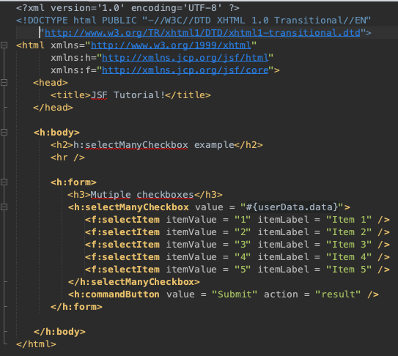
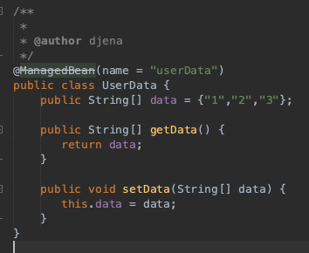
Page (xhml) & Bean Class (Java)

Slide 5
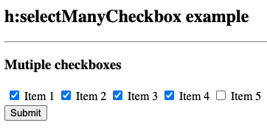

Output

Slide 6
Reference
No Author. (n.d.). Tag selectManyCheckbox. Retrieved from https://docs.oracle.com/javaee/6/javaserverfaces/2.1/docs/vdldocs/facelets/h/selectManyCheckbox.html.

